Slide 1
Graphic design intern guide V2
By CarynChong
Updated by Loh Kai Jun

Slide 2
Simple Introduction to ASUS
Categories
ROG (Republic of Gamers)
TUF Gaming
ASUS
ProArt
ZenScreen
Products
Gaming Gear (mouse, keyboard, headset, earphone, other peripherals)
PC components (motherboard, graphic cards, LCD, SSD, casing, cooler…etc)
Router
PBA (Powered By Asus) – More than one ASUS product in a setup

Slide 3
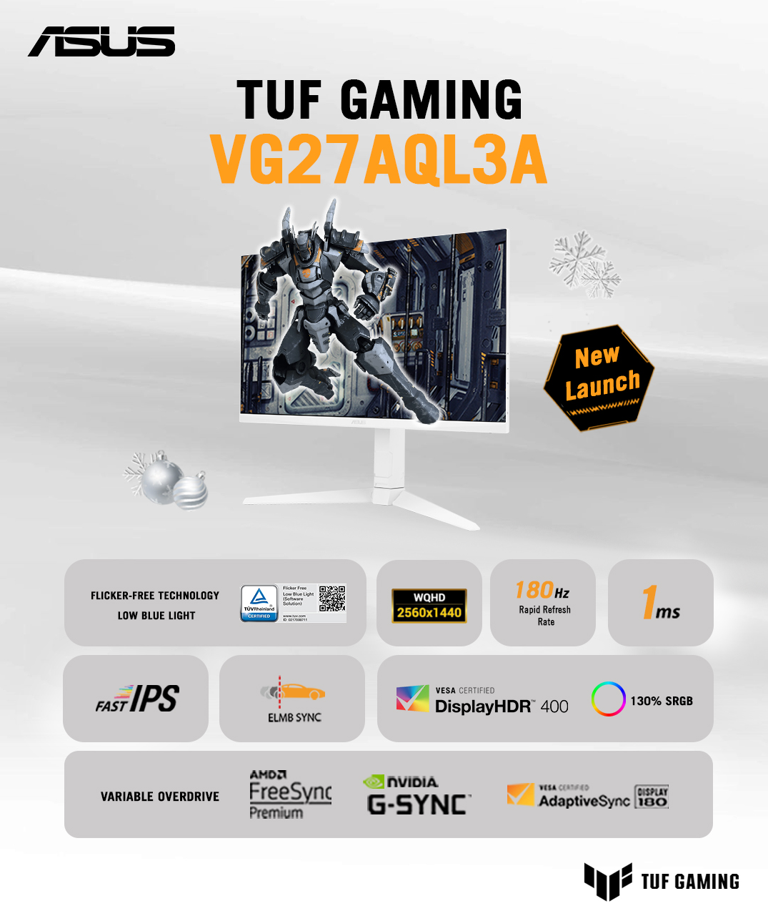
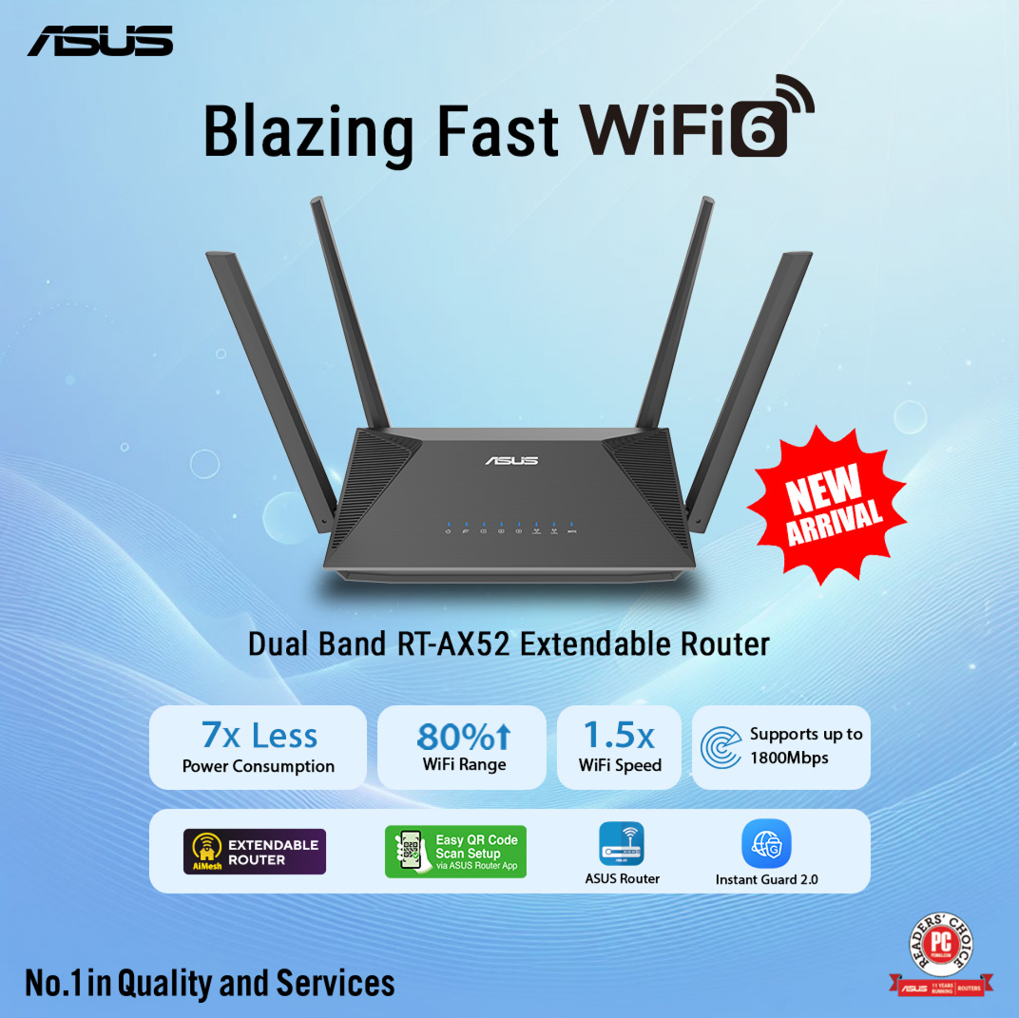
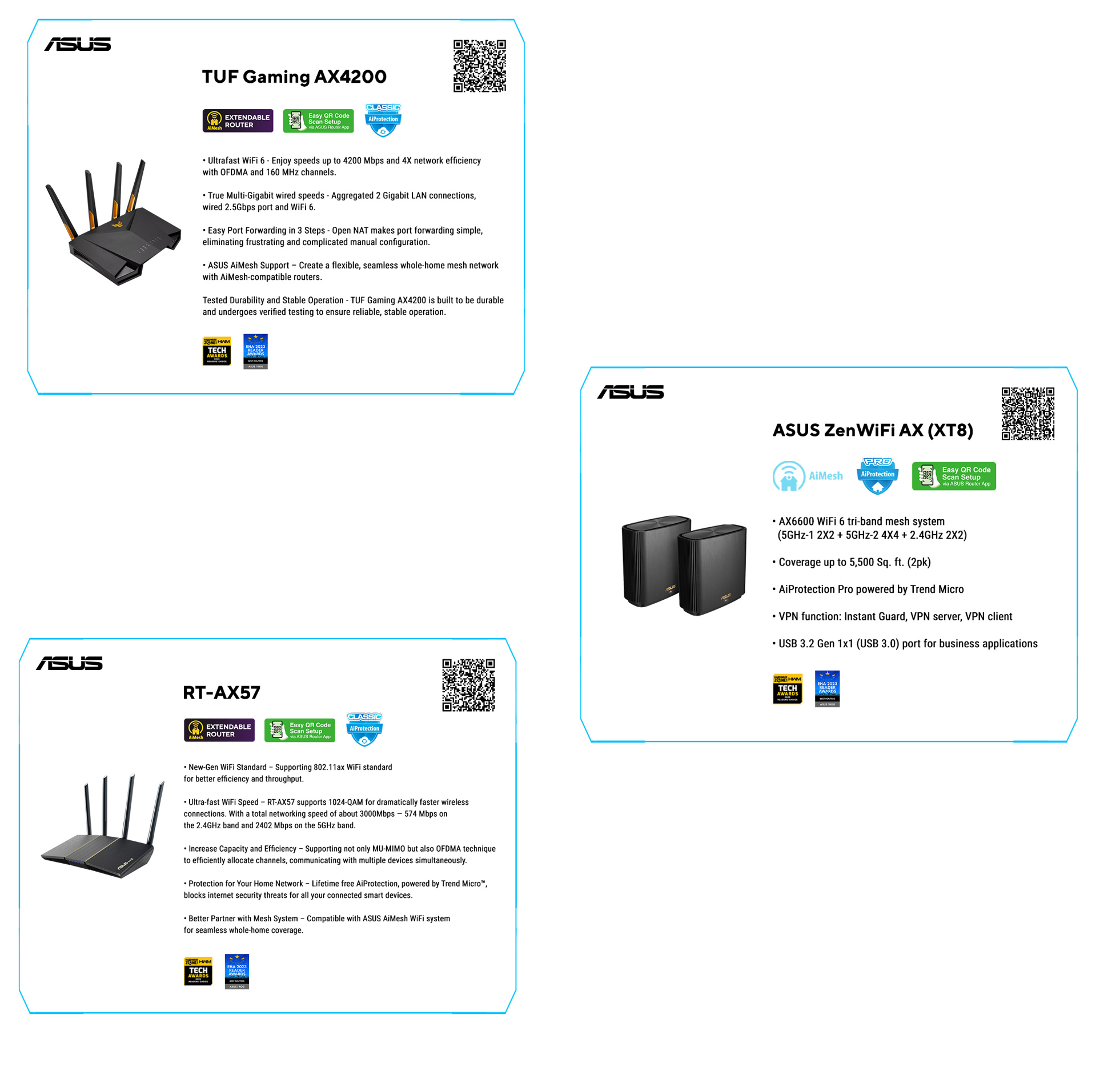
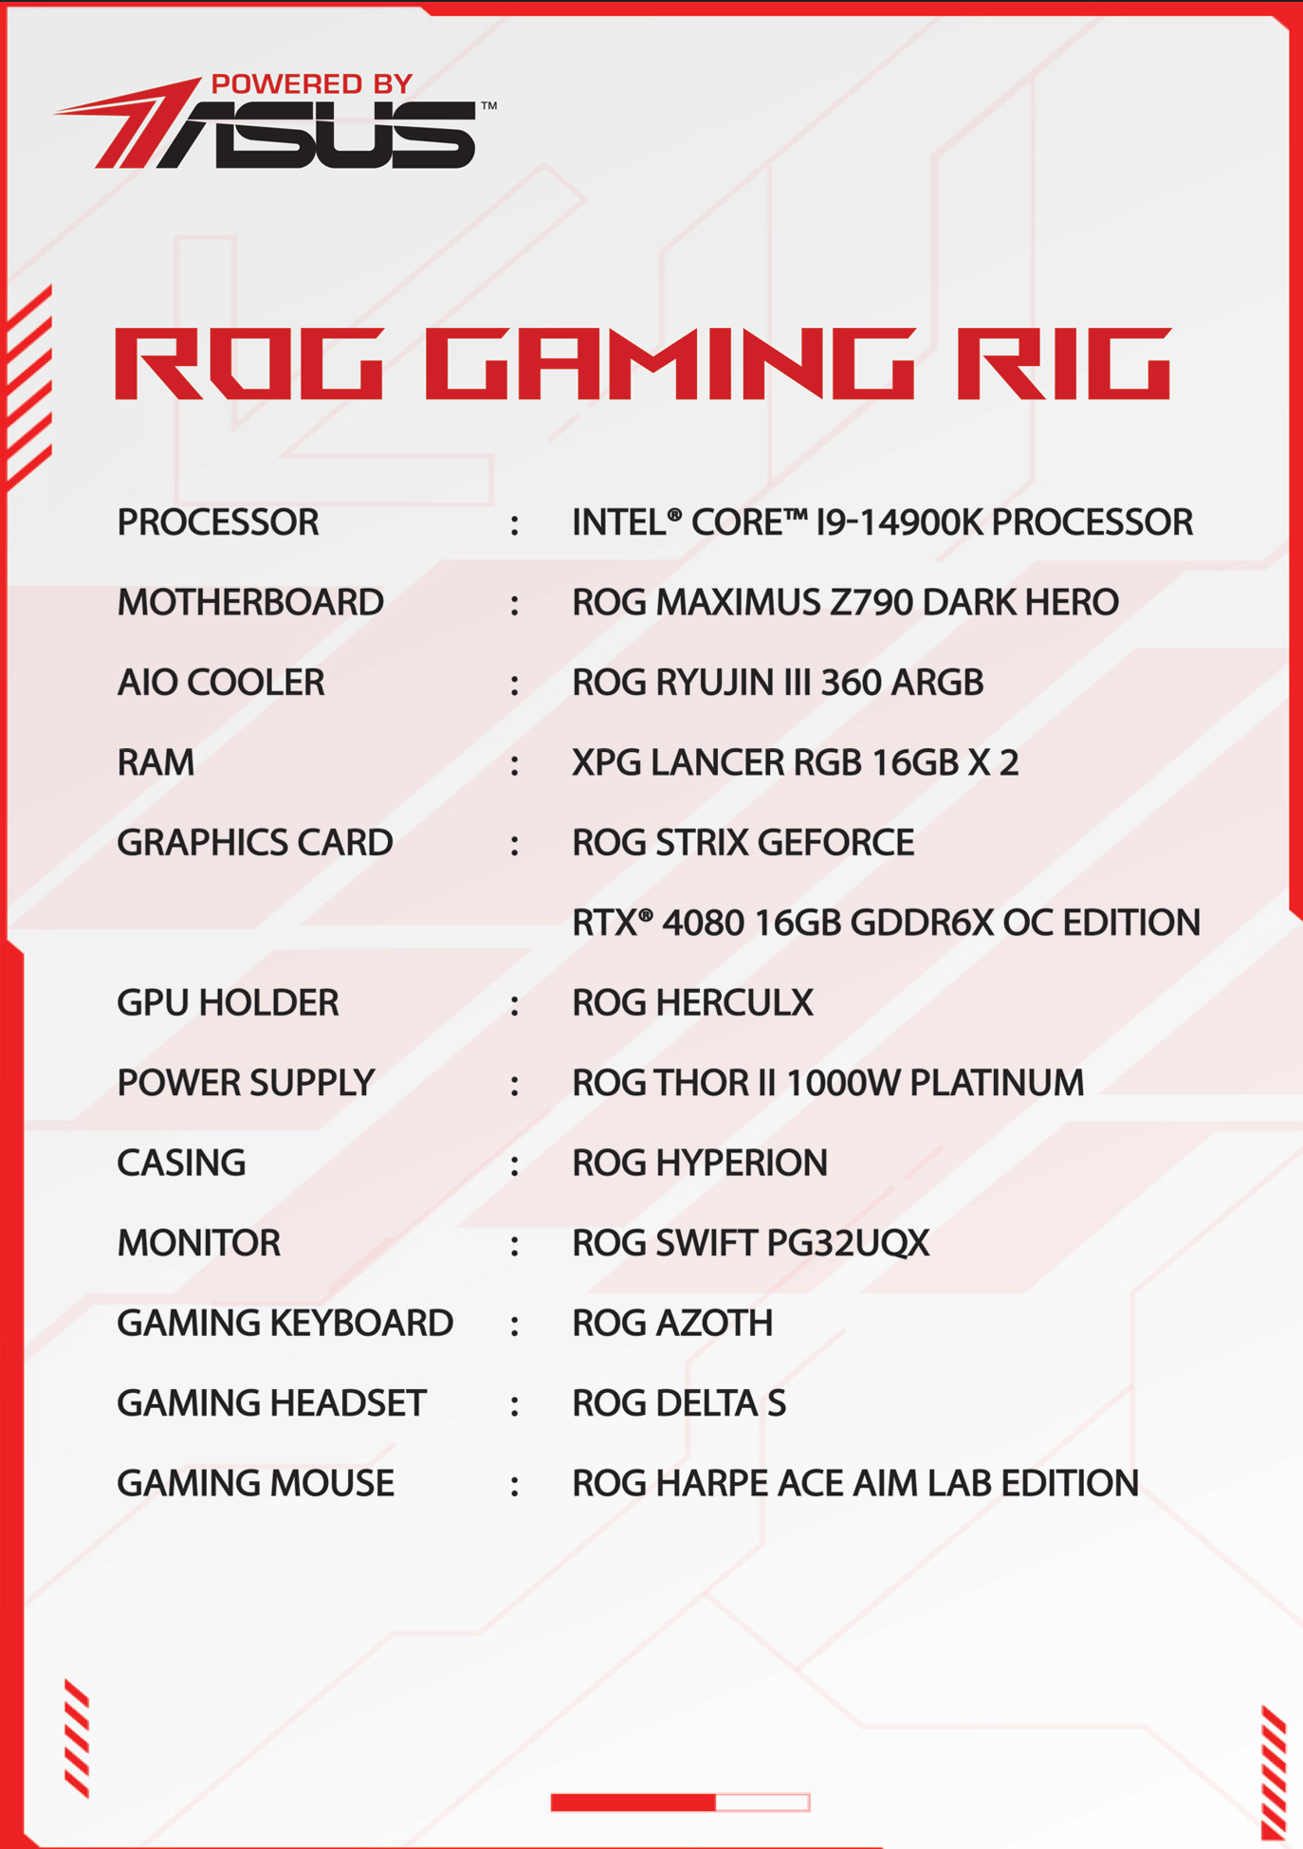
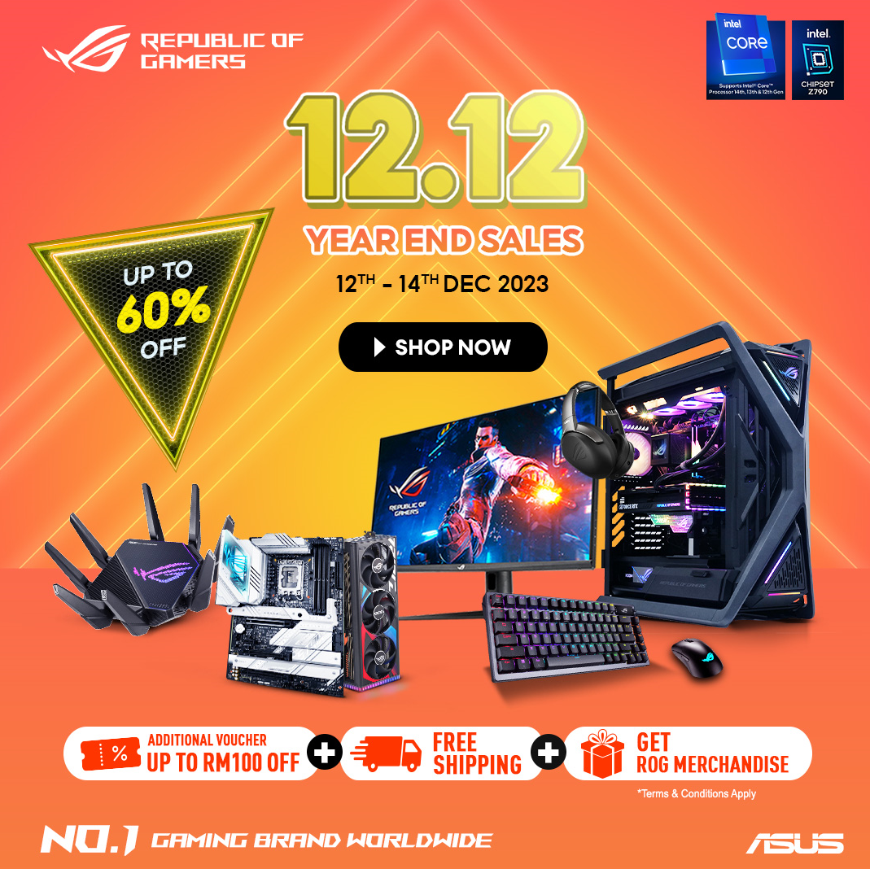
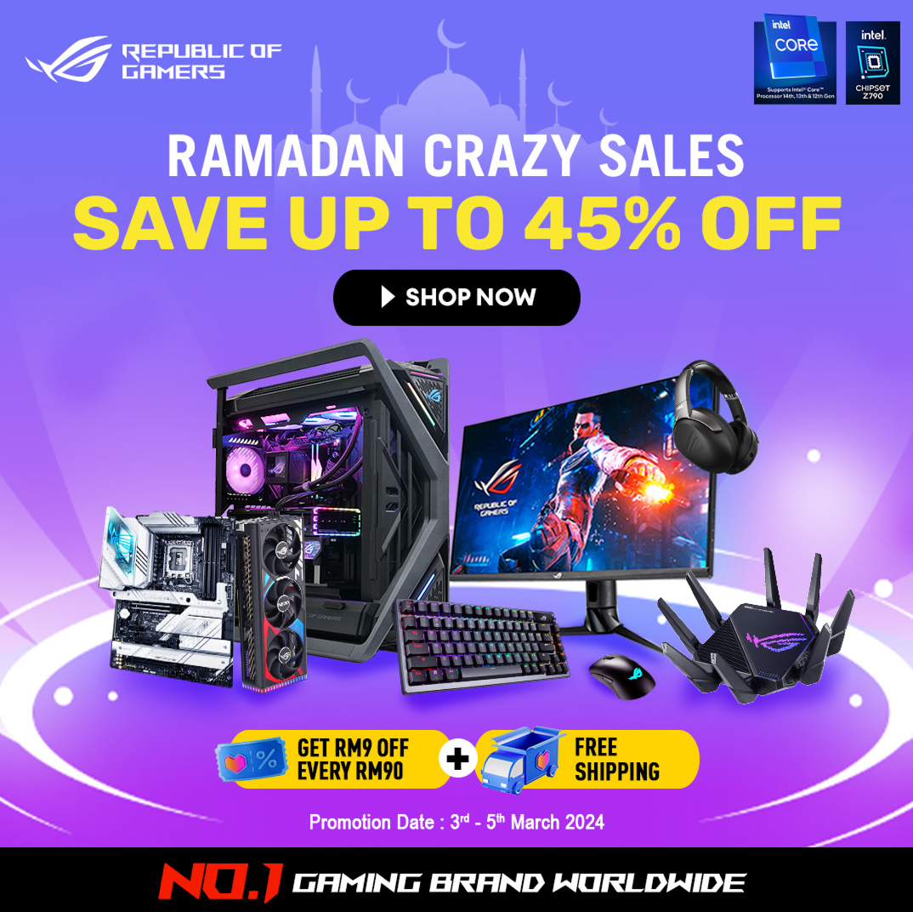
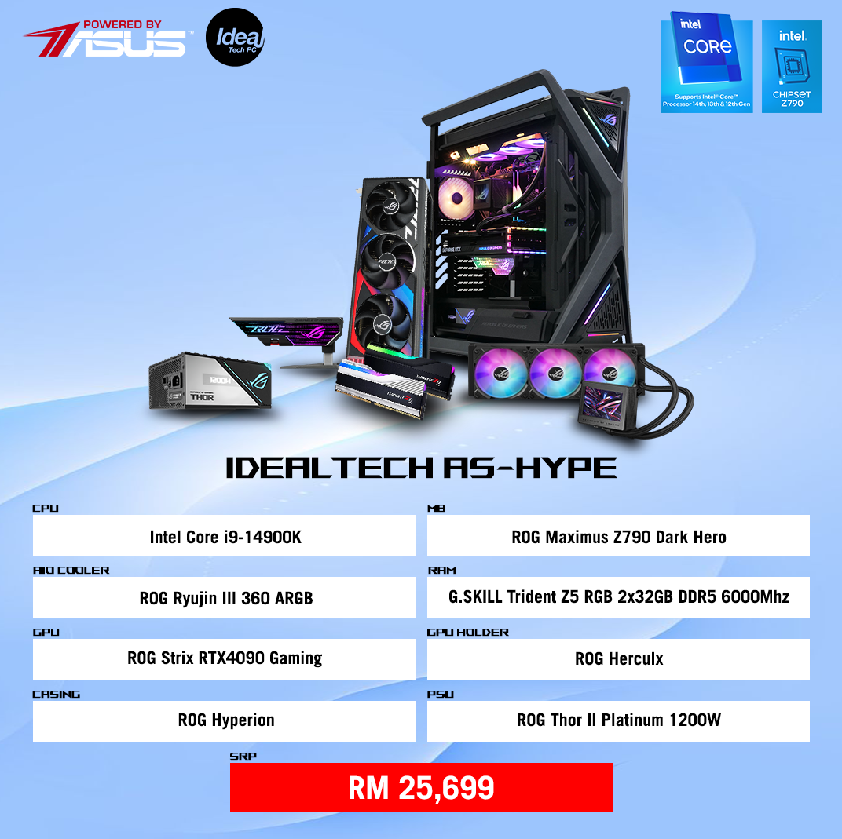
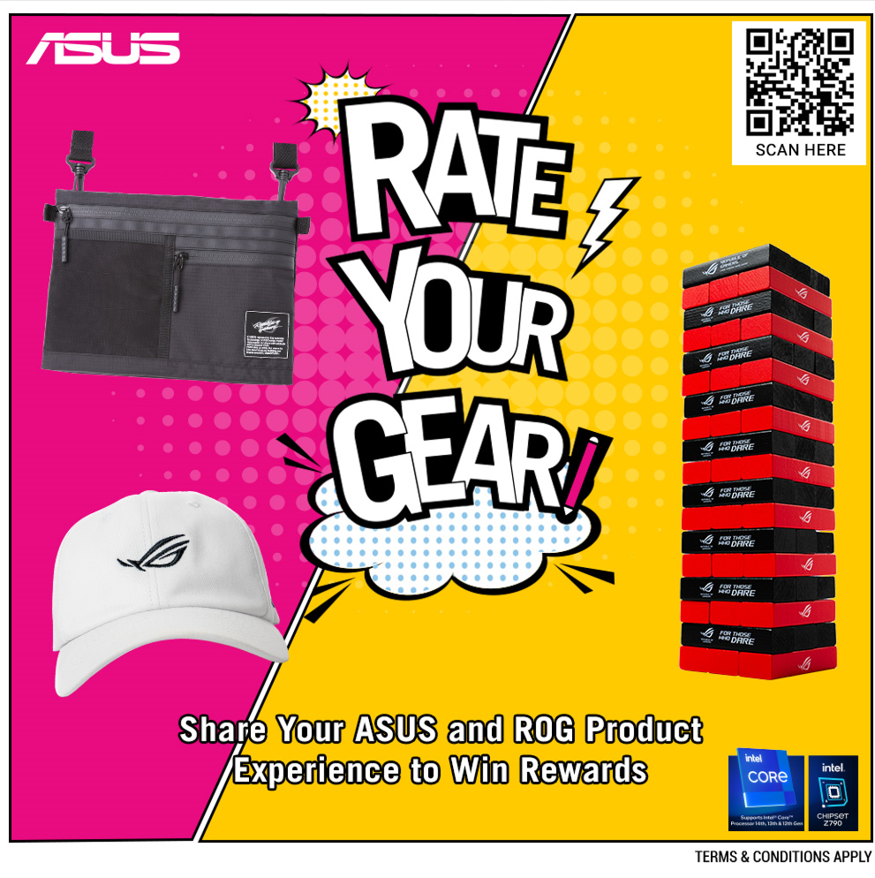
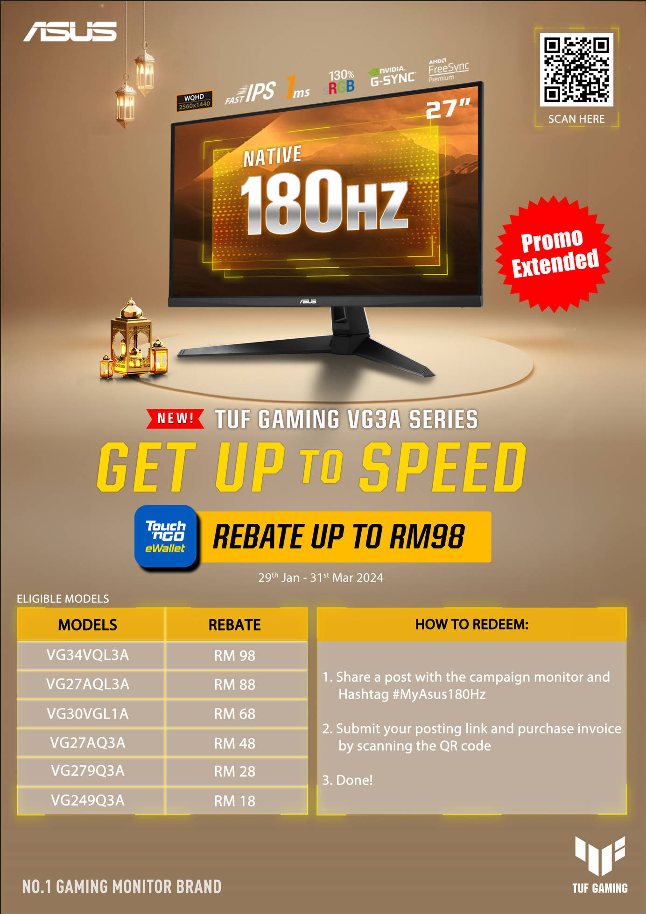
Scope
Social posting artwork
Spec card
Double digit artwork
Promo/PWP/Wobbler
By: Caryn Chong

Slide 4
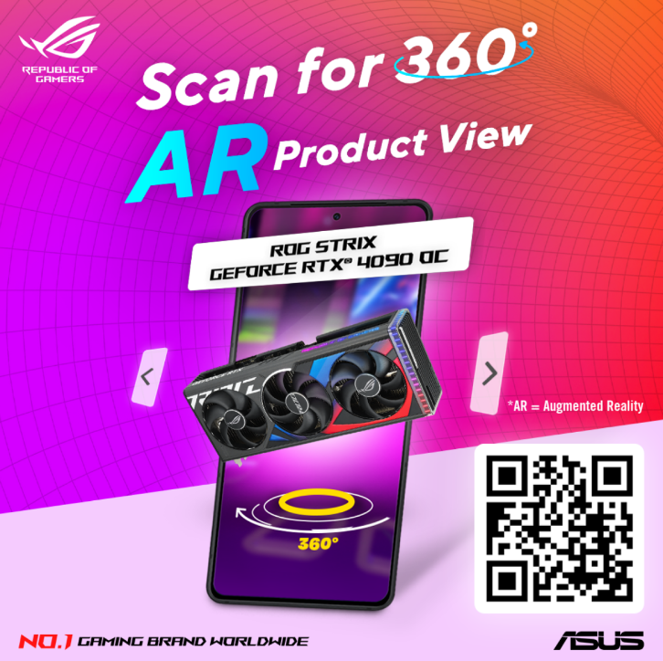
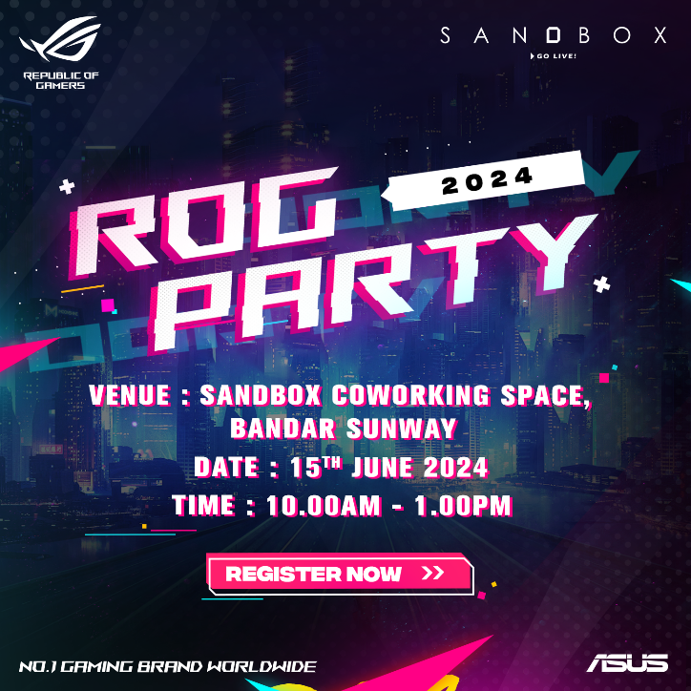
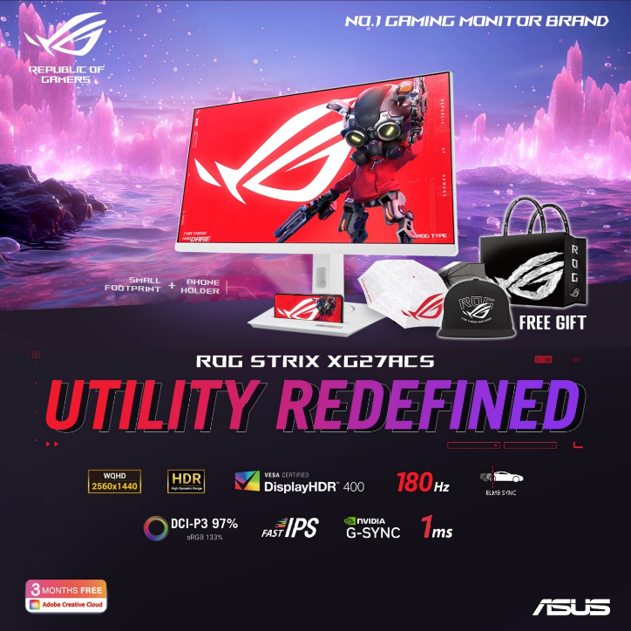
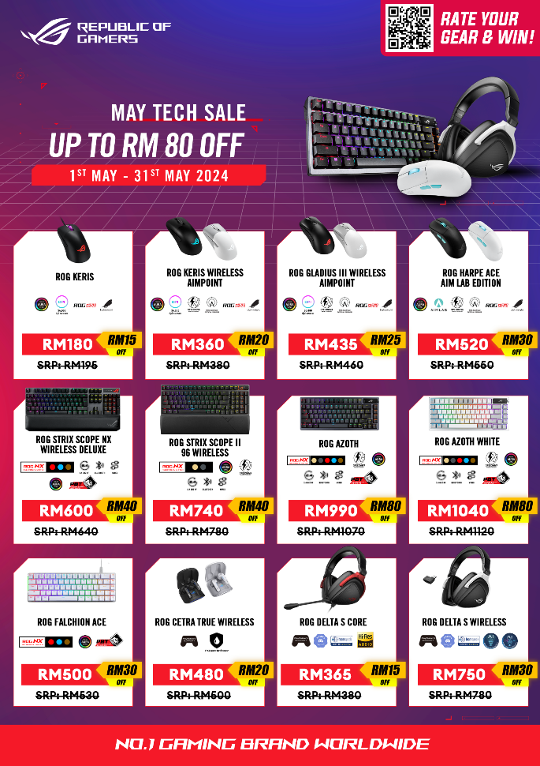
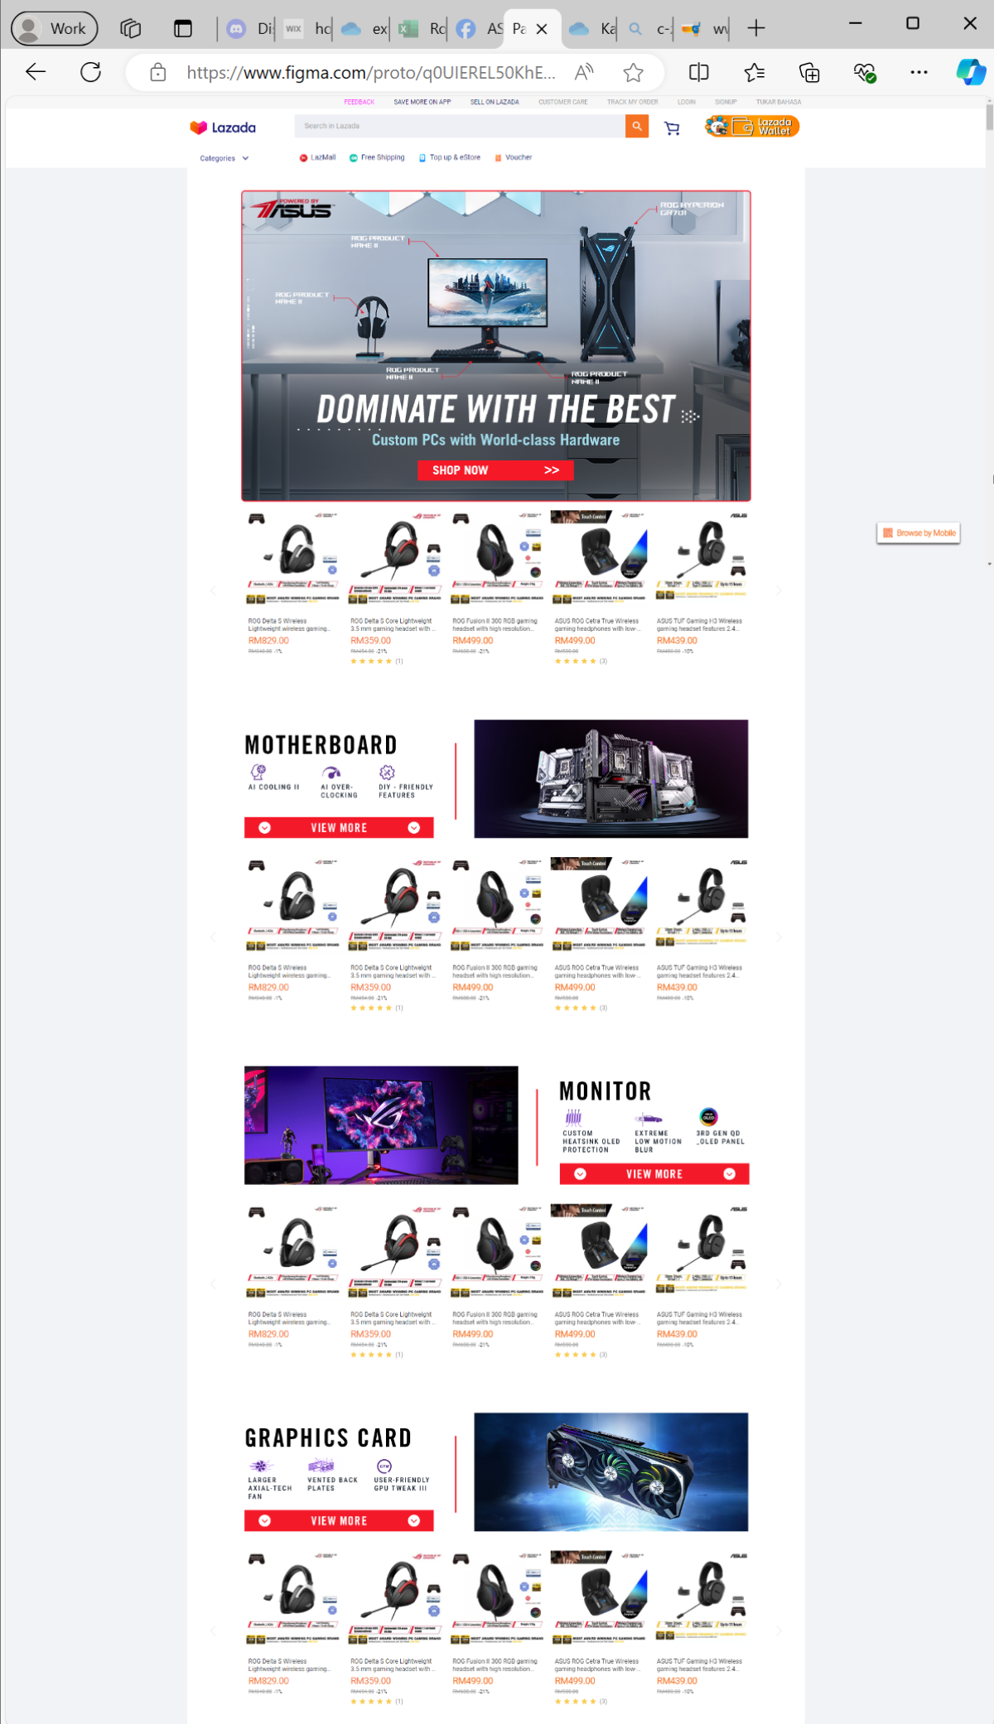

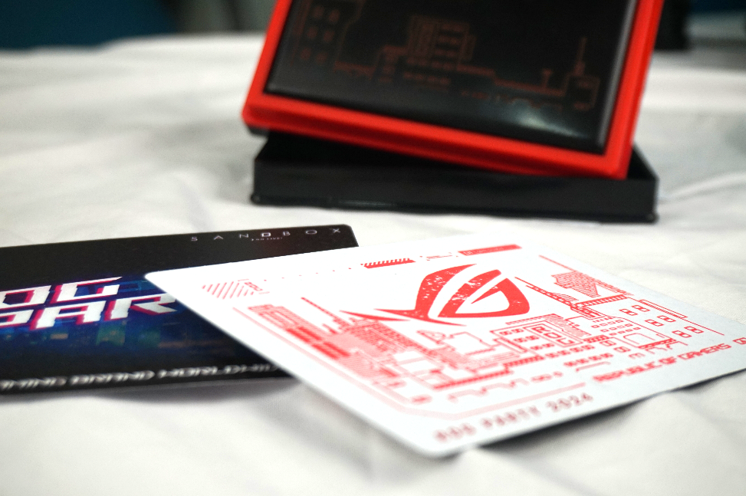
Wobbler
Event Invitation
Social media ad
Promotion
Banner
By: Kai Jun
Landing Page
Stamp

Slide 5
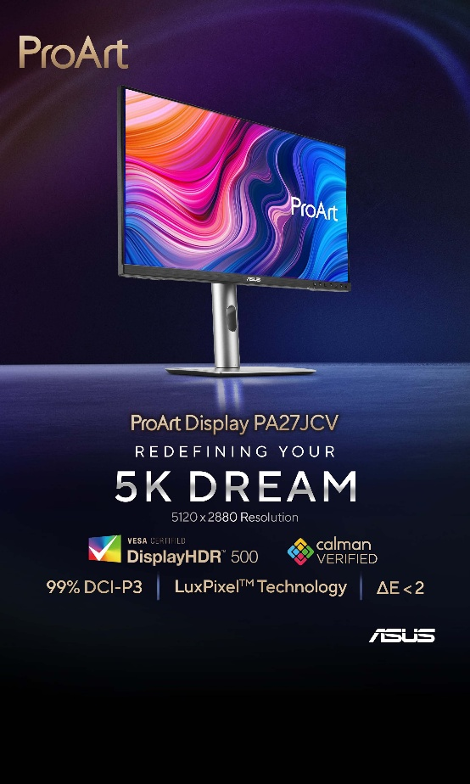
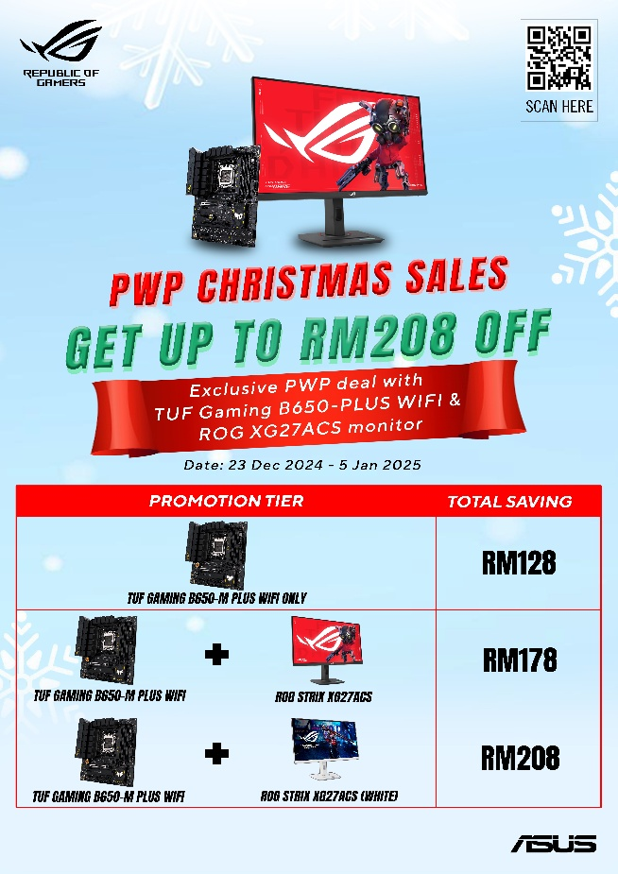
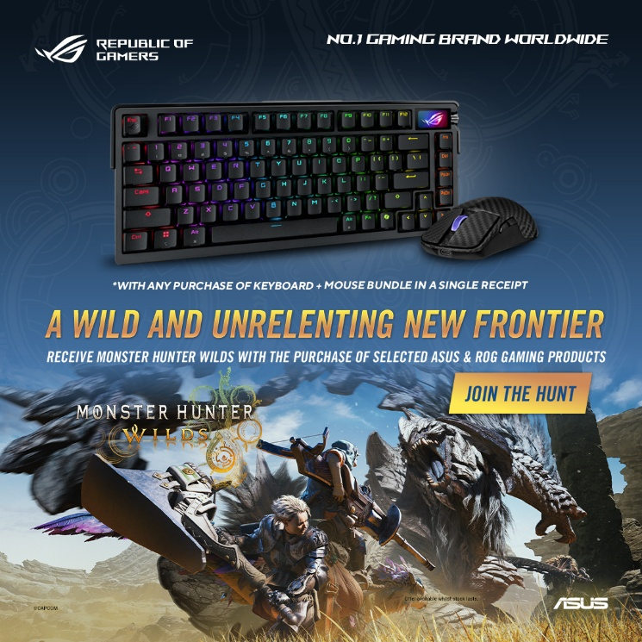
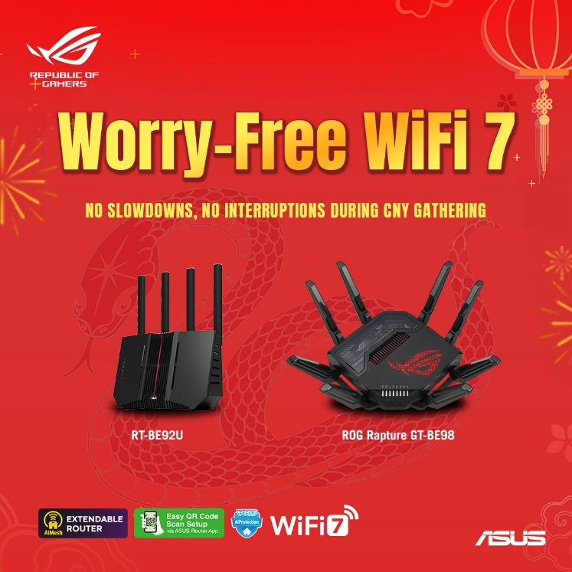
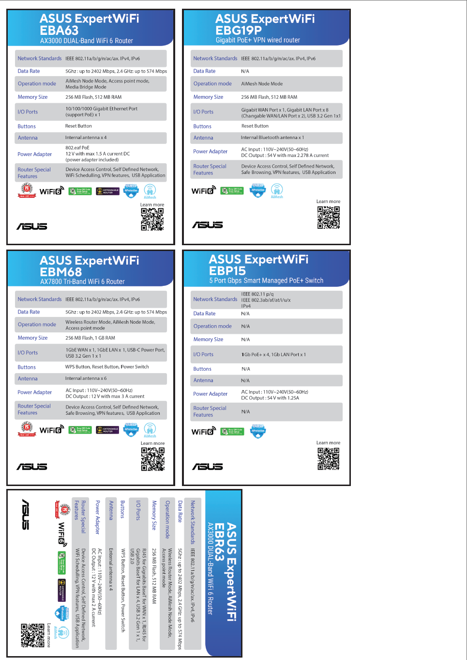
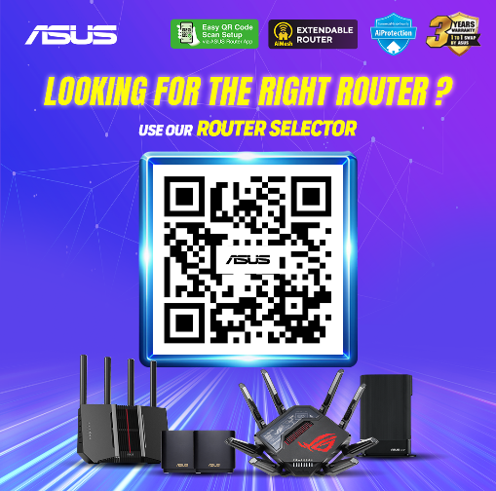
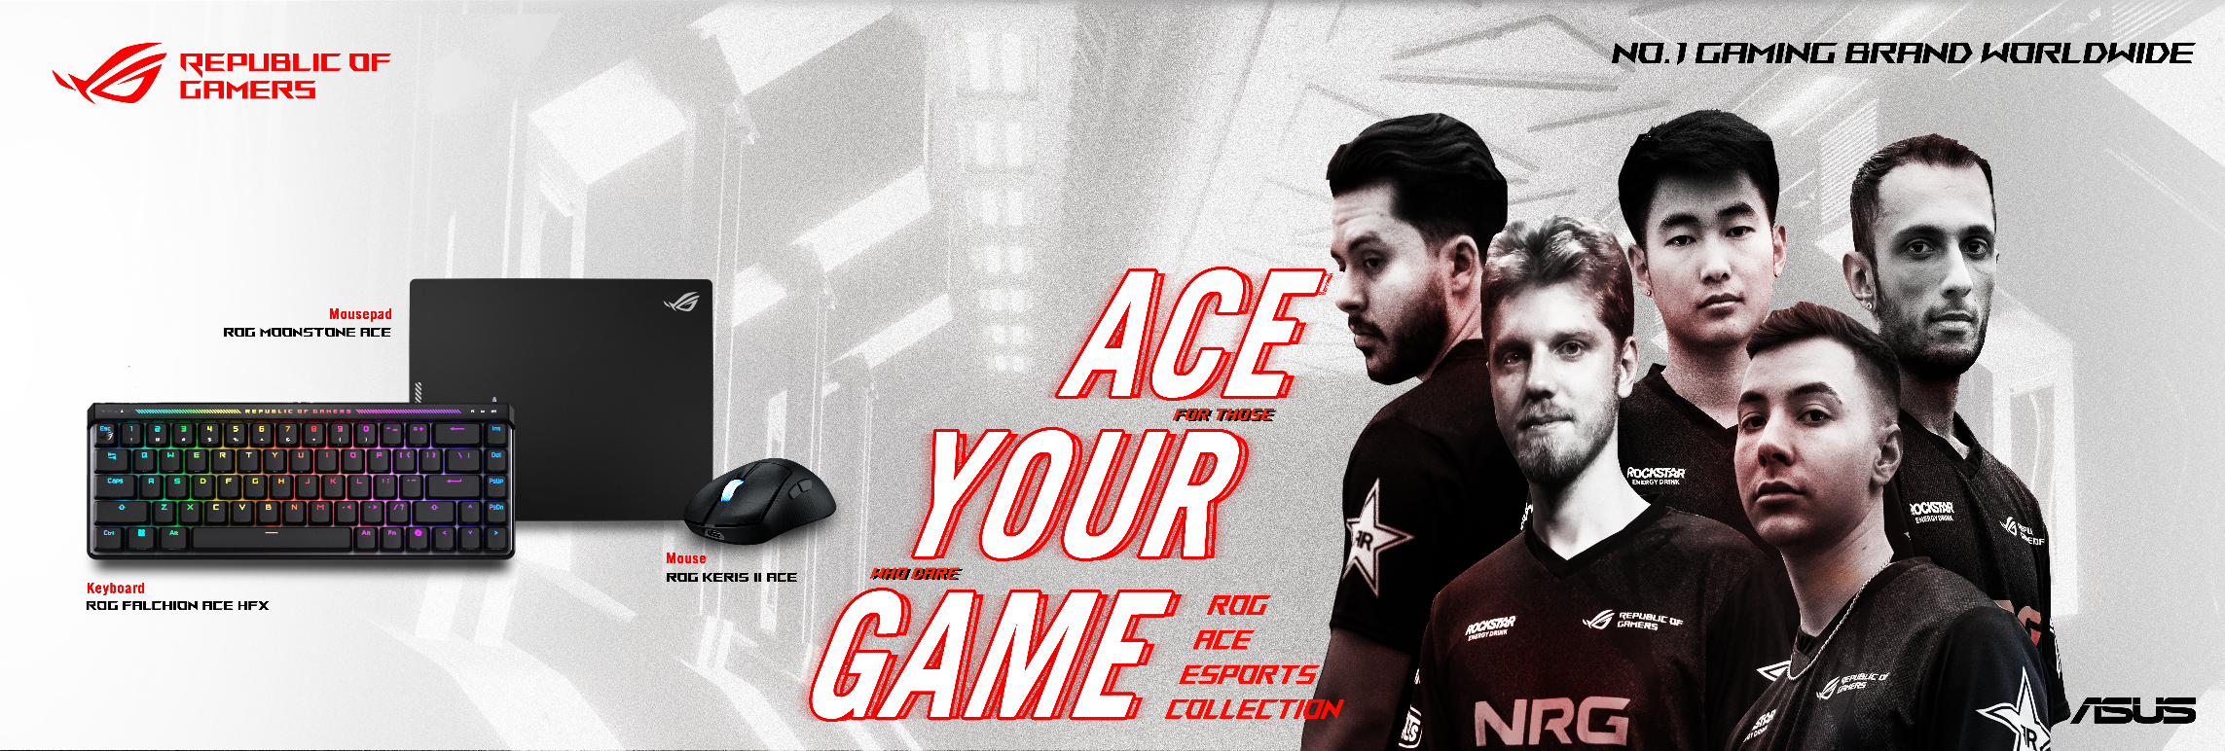
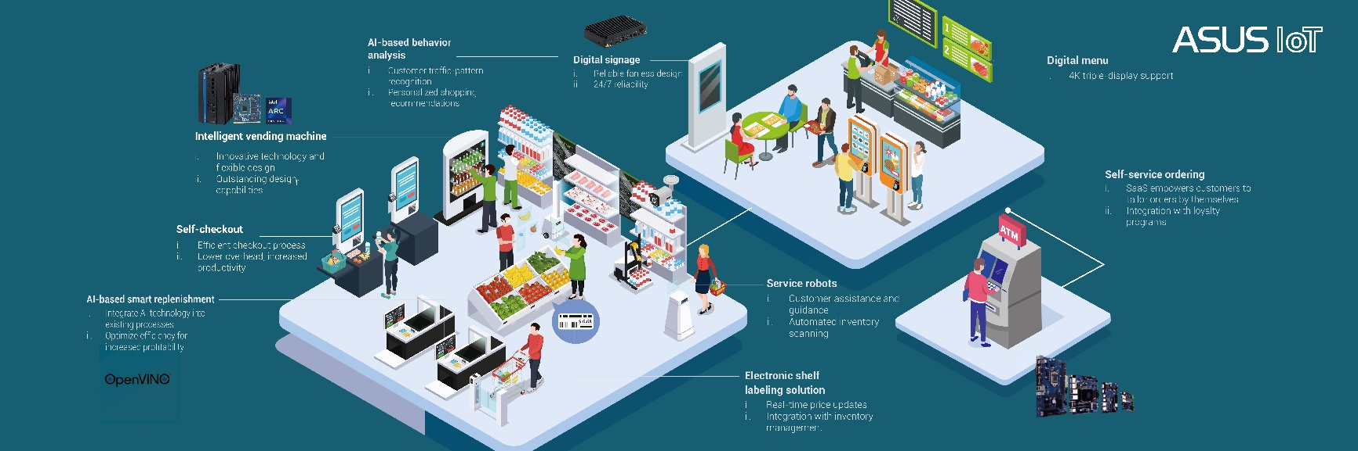
Monster Hunter
promotion
CNY Router boosting
AES
Promotion
Event Spec Card
Wobbler
Lightboard
By: Kerwin
AIOT

Slide 6



ASUS WEBSITE BANNER
Desktop: 5120 x 1554 px
-Green zone guildline : TOP: 320
LEFT: 1400
BOTTOM: 110
RIGHT: 1410
Tablet: 2560 x 1396 px
-Green zone guildline : TOP: 210
LEFT: 570
BOTTOM: 130
RIGHT: 590
Mobile: 1460 x 1096 px
-Green zone guildline : TOP: 145
LEFT: 435
BOTTOM: 120
RIGHT: 425

Slide 7

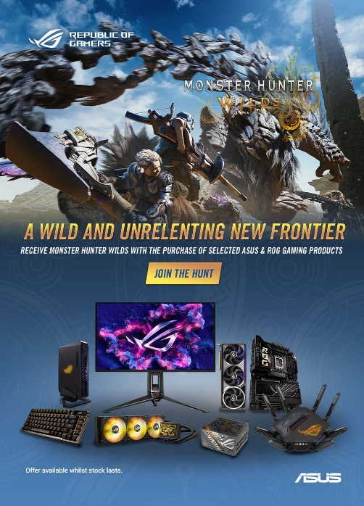
ROG WEBSITE BANNER
Desktop : 1920 x 740 px
No need green zone
Mobile : 1080 x 1500 px
No need green zone

Slide 9
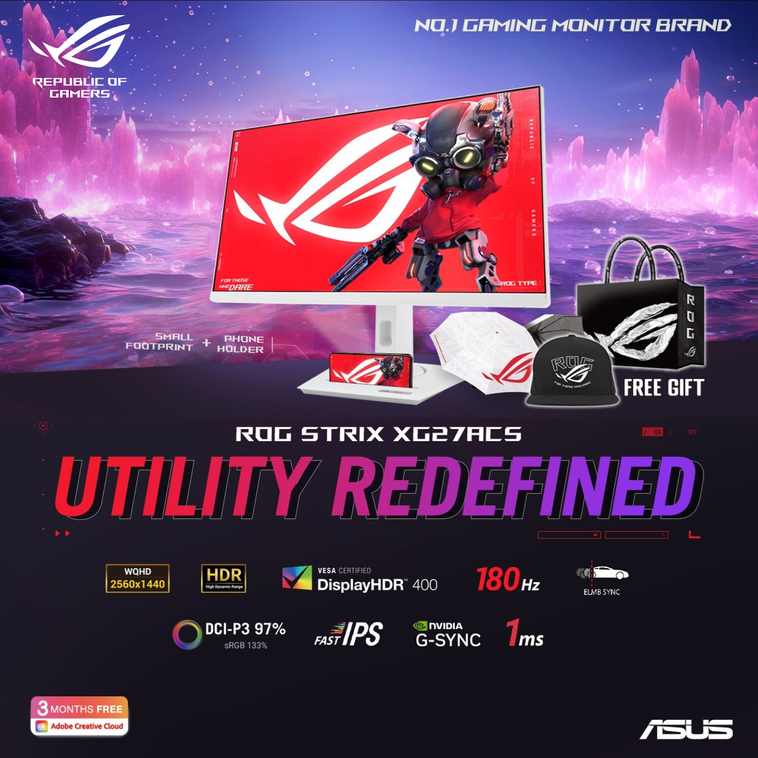
Concept
1s, 10s, 1min
Clear and simple
Lower the priority, smaller /
less prevalent the elements
Google visual hierarchy to learn
more
1s
10s
1 min

Slide 10
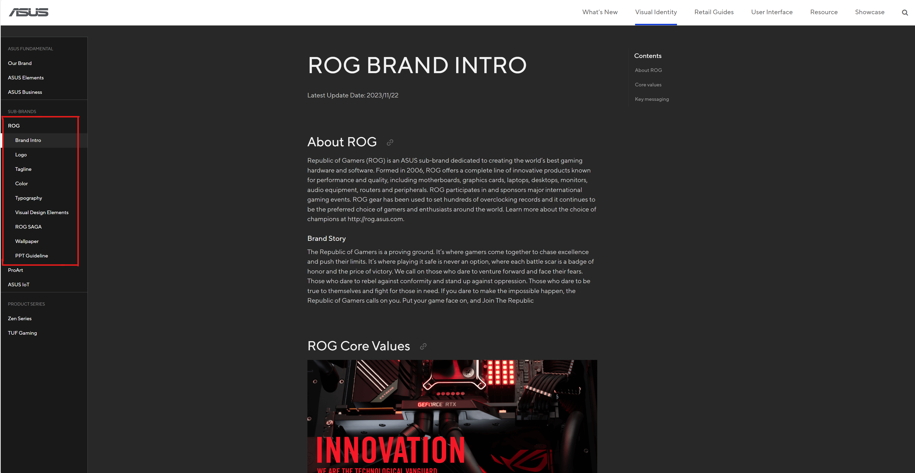
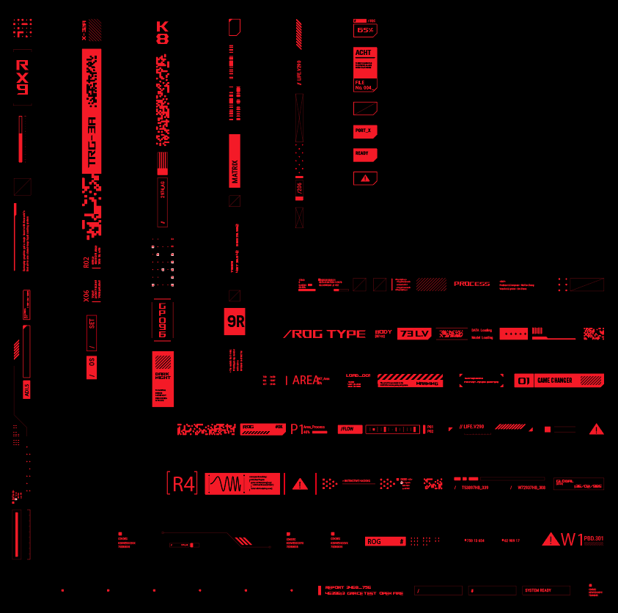
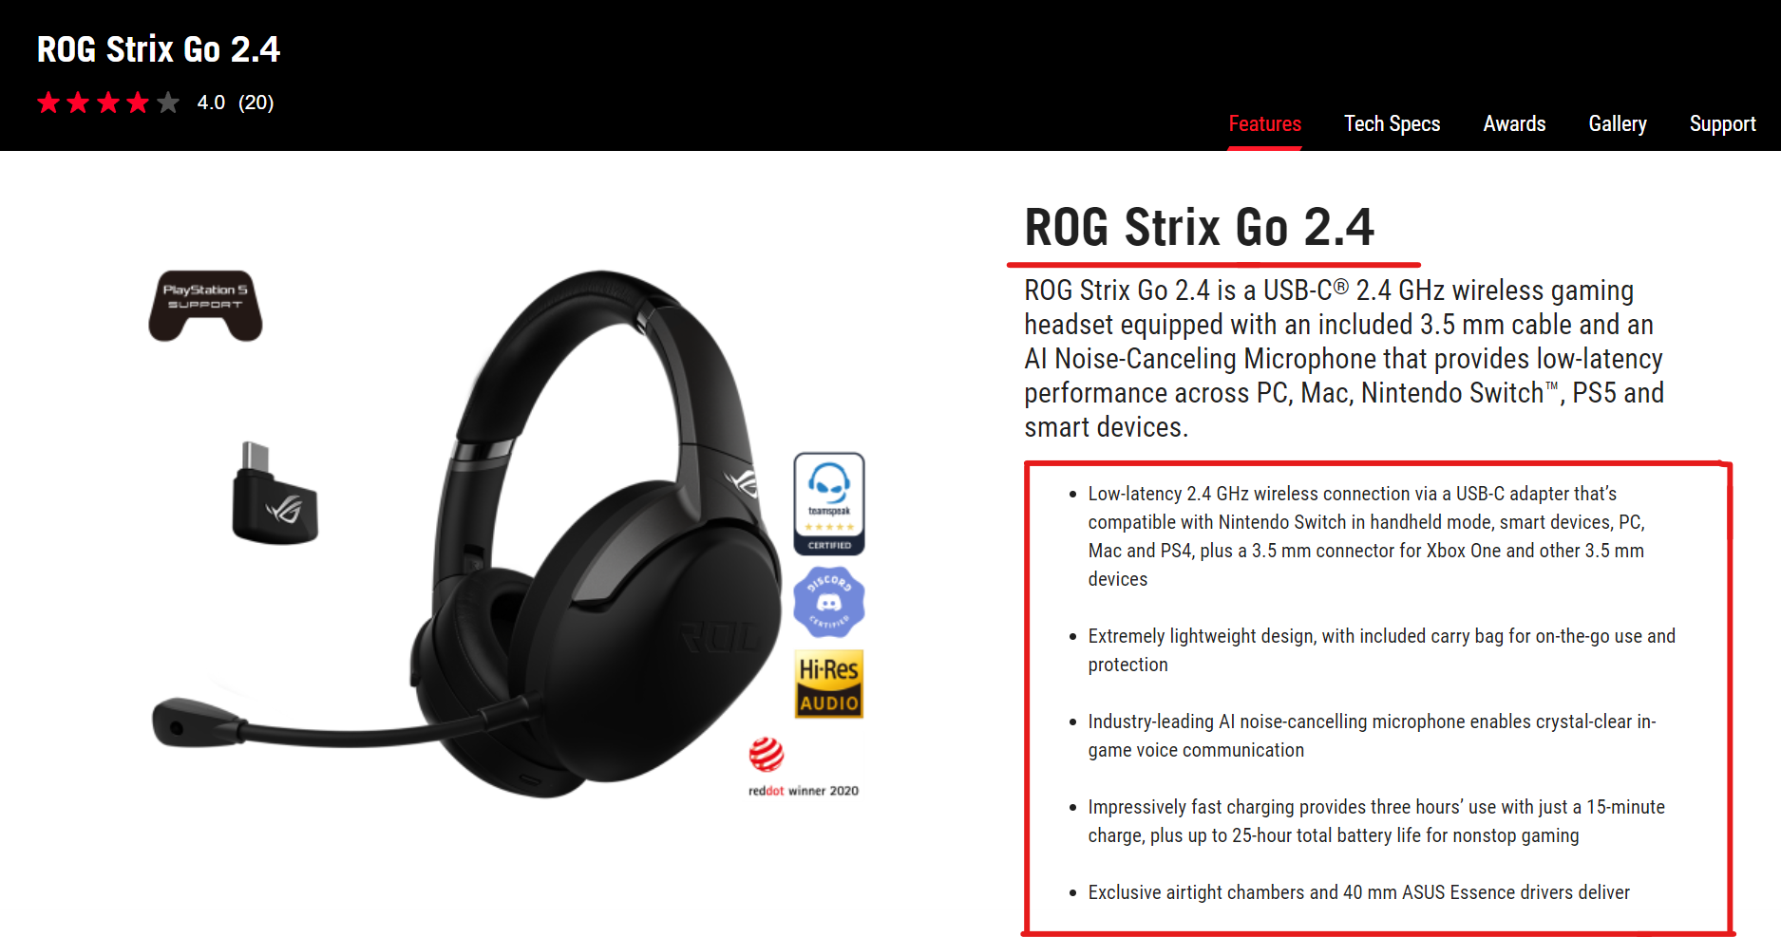
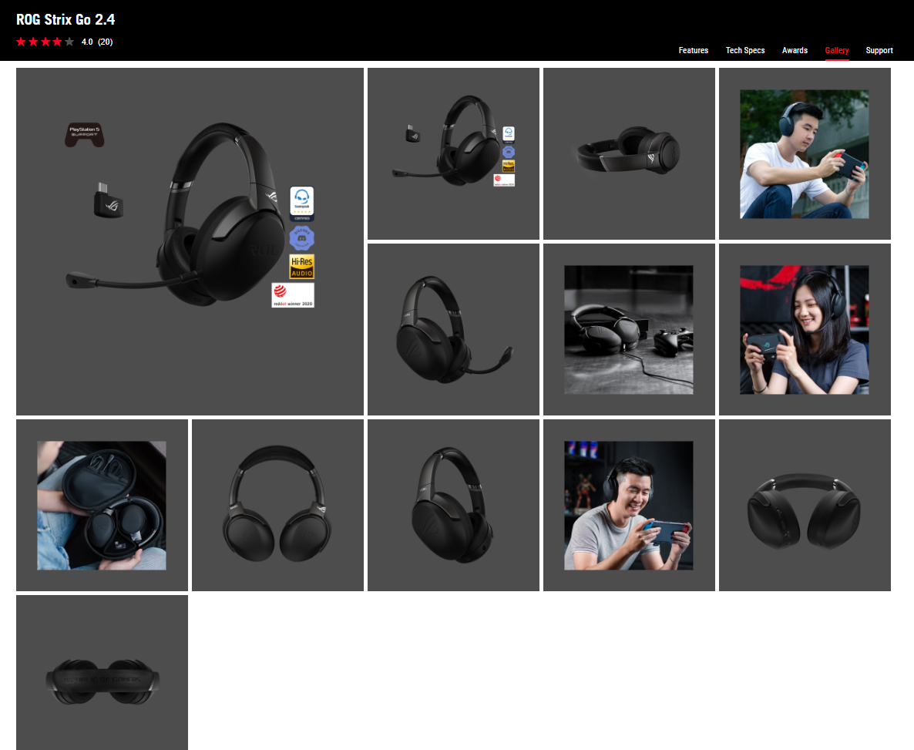
Resources
Brand Unity
ASUS – Brand Unity
Color scheme
Font
Tagline
Logo
Graphic visuals
Product Webpage
Full product name
KSP (Key selling point)
Product photo

Slide 11

Layout
Make sure to leave equal space at all sides of the template
Social posting: 1080 x 1080 pixel (Guideline all 20)
Wobbler: 10cm x 10cm
Spec card: A5/A6 (refer to template)
Bunting: 29.5x80 inches

Slide 12


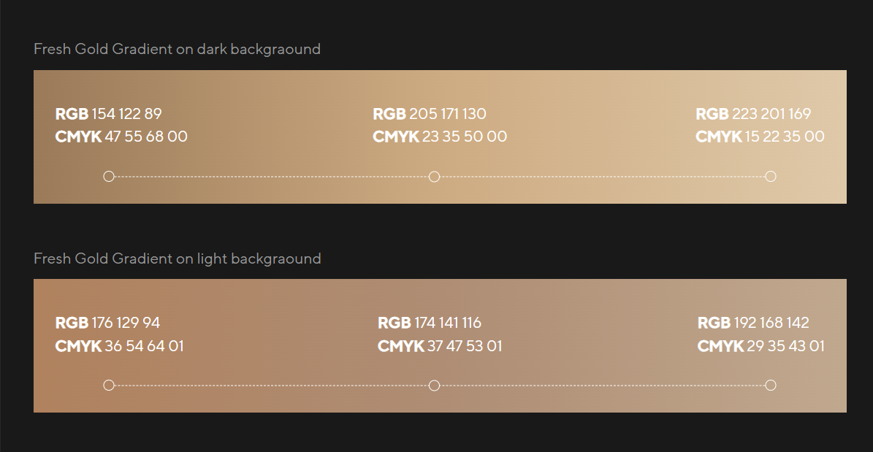


Color
All can be obtained from ASUS Brand Unity
ROG
RED: #F51928
Black: #000000
TUF
Yellow: #FF9E1B
Black: #000000
ProArt
Gold
Black: #000000
ASUS
Blue: #133ED4
Grey: #53565A, #D9D9D6

Slide 13
Fonts
All can be obtained from ASUS Brand Unity
Categories | Primary Font | Additional Font 1 | Additional Font 2
ROG | ROG Font | Trade Gothic LT Pro (*use this font for tagline) | Roboto Condensed
TUF | Kairos Sans Condensed | DIN Pro Condensed Bold | Roboto
ASUS | TT Norms Pro | Roboto | -
ProArt | TT Norms Pro | Roboto | -
ZenScreen | TT Norms Pro | Roboto | -
For Titles and Badges you may use other fonts freely.

Slide 14
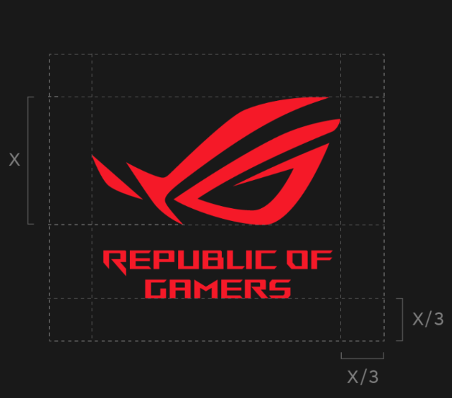

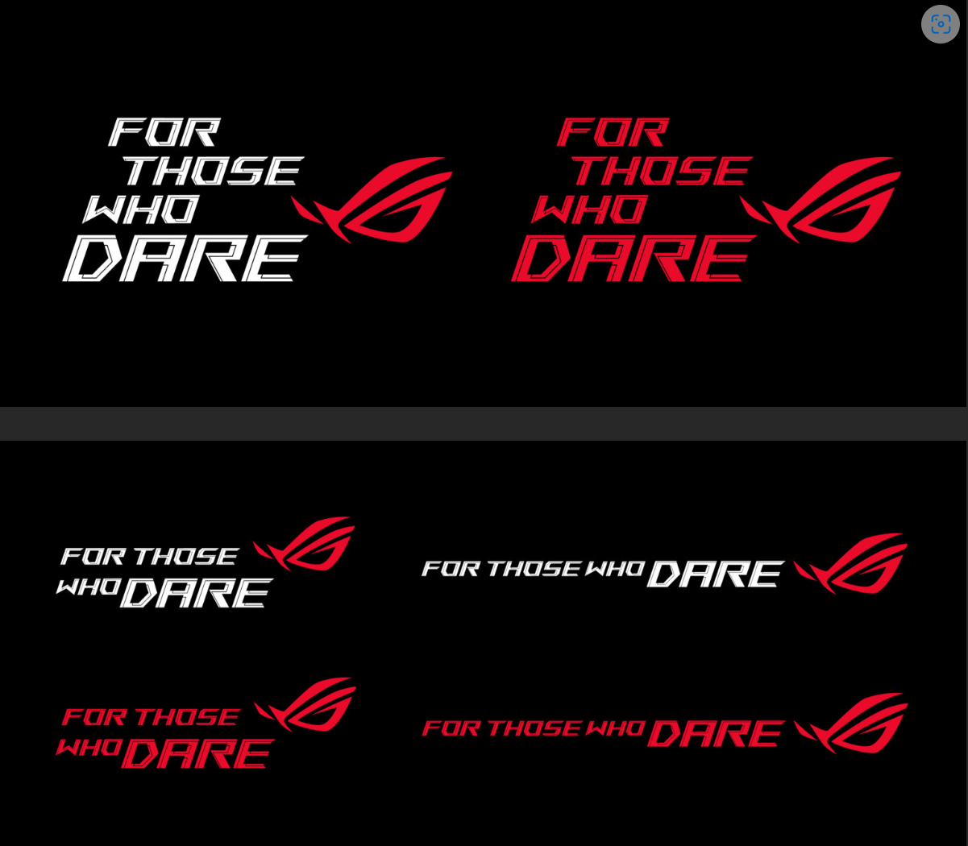


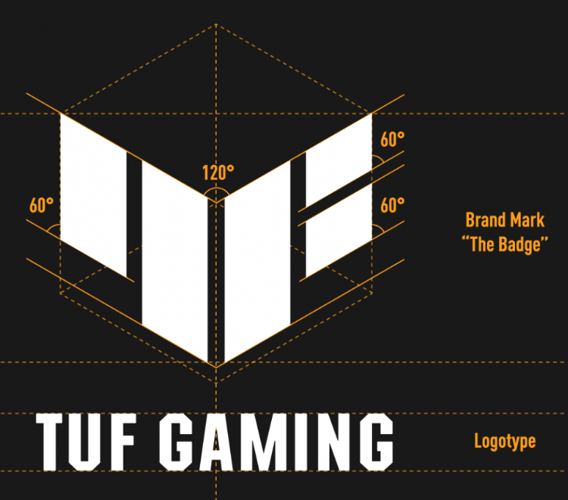





Logo & Taglines
All can be obtained from ASUS Brand Unity
Categories | Logo | Taglines
ROG
TUF | *Note: look at the product (old TUF logo & New TUF logo) | Get TUF, Game Tough
ASUS
ProArt
ZenScreen
PBA (Powered By ASUS) |  | DOMINATE WITH THE BEST

Slide 15

Arrangement Priority
Arrangement of logo, tagline according to priority
1 as most prio to 4
ROG > ASUS
ASUS > TUF
Logo > Tagline

Slide 16
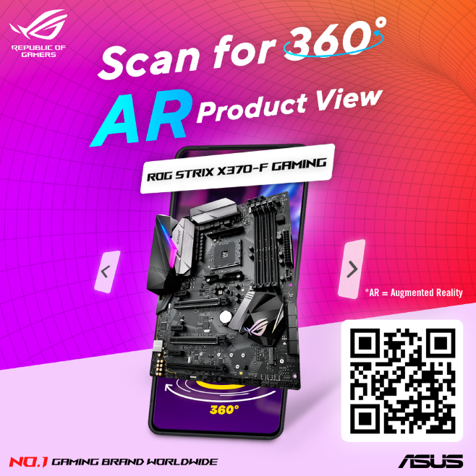
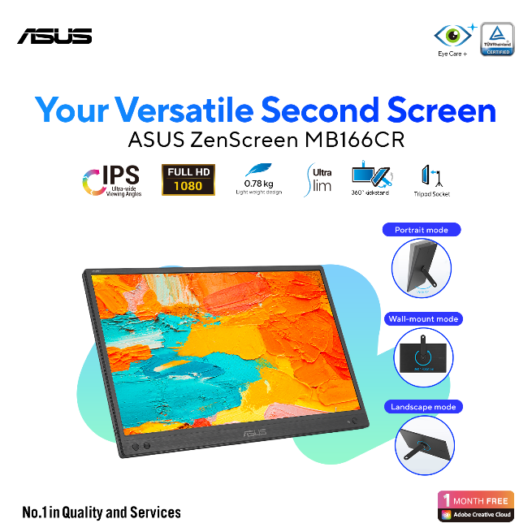
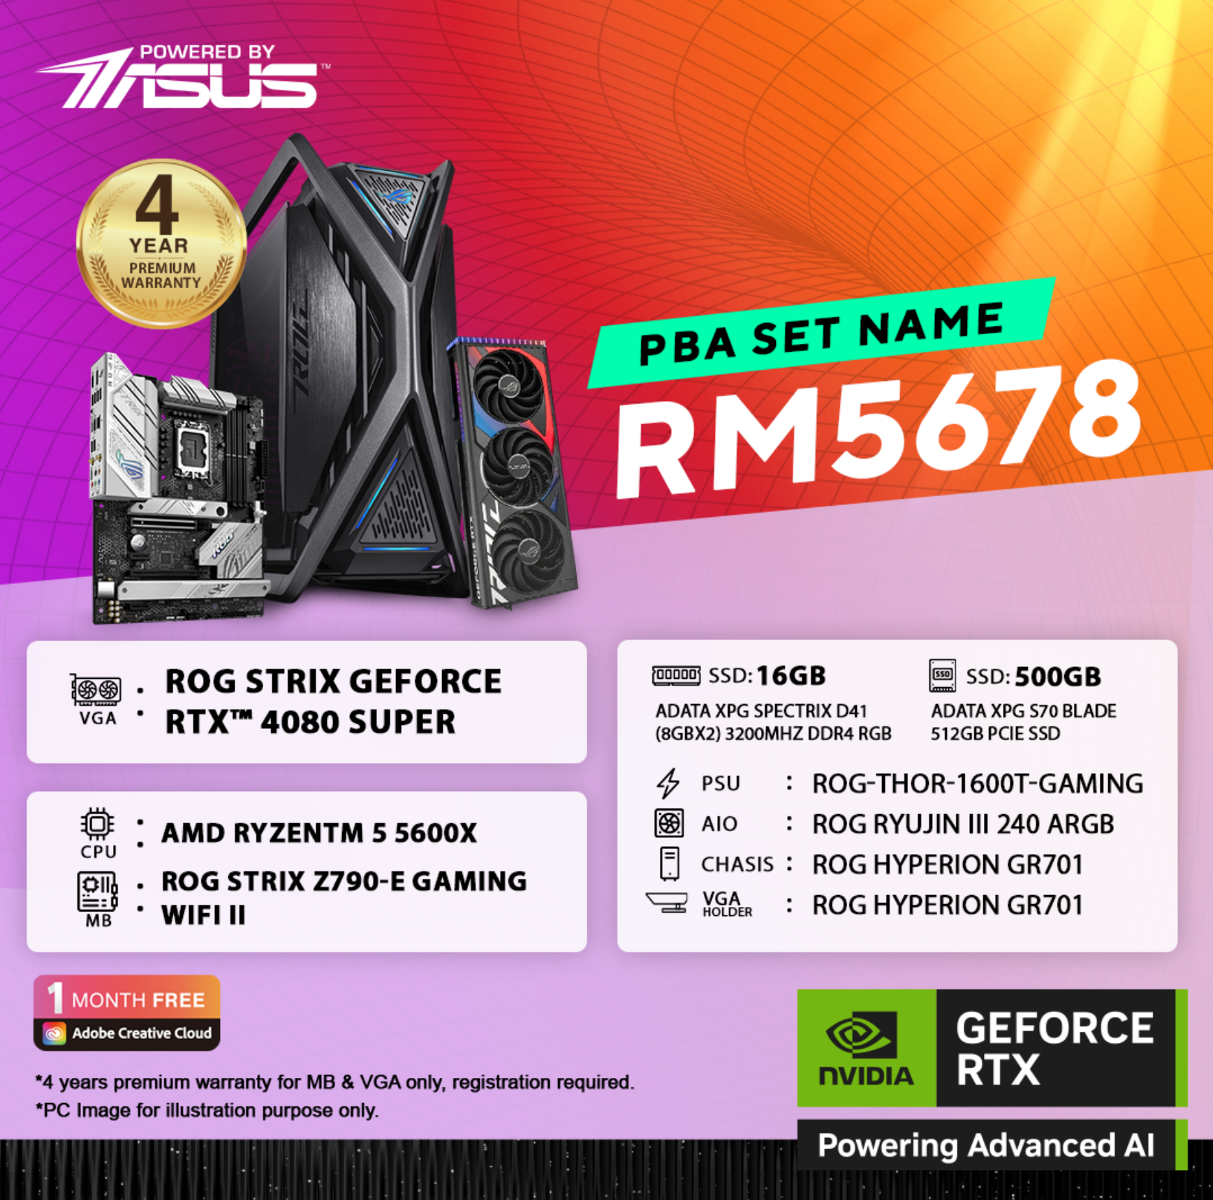
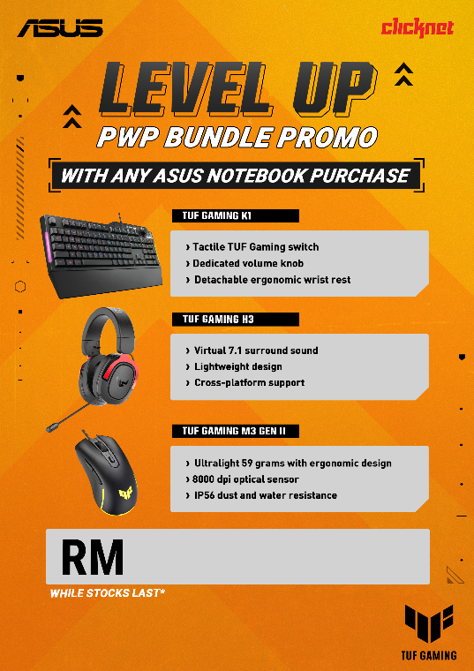
Logo Arrangement case study
ROG Product
ASUS Product
PBA Product
1
1
1
ROG Logo
ASUS Logo
PBA Logo
1.5
2
ROG Tagline
3
2
ASUS Tagline
partner
ASUS Logo
TUF Product
1.5
1
Dealer/Partner logo always on top right
Use the logo color ver with best contrast
Vertical and horizontal pading should be the same
ASUS Logo
Dealer logo
2
TUF Logo

Slide 17
Content Check List

Slide 18
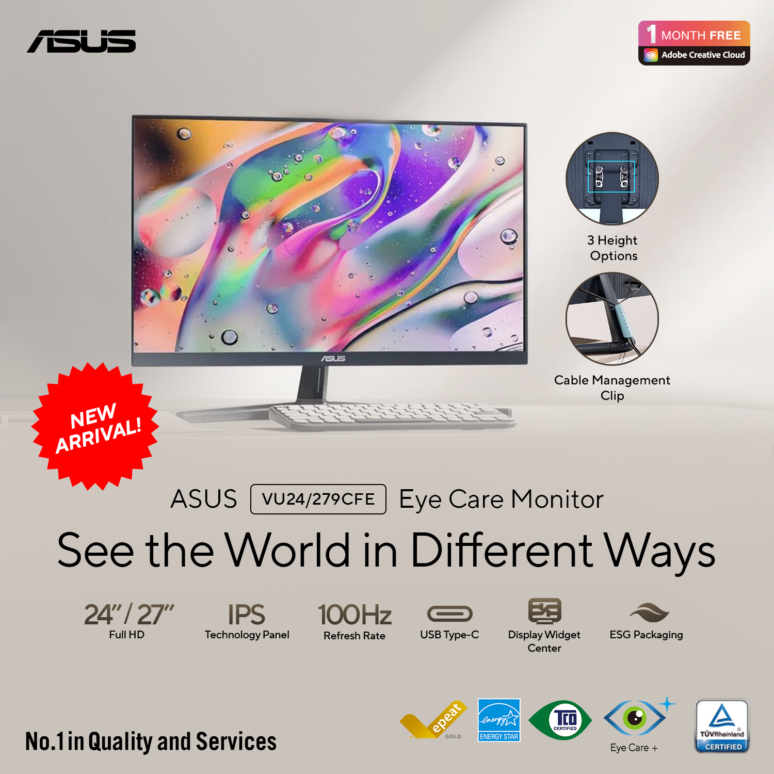
Content
Social Posting
Logo
KSP
Product Pic
Badge
(depending on the use of artwork)
Product Name
Title
(Product Tagline)
KSP
Tagline
KSP Logo

Slide 19
Content
Social Posting
Logo
Product Name
Product Pic
Badge
(depending on the use of artwork)
KSP
(Key Selling Point)
Logo

Slide 20
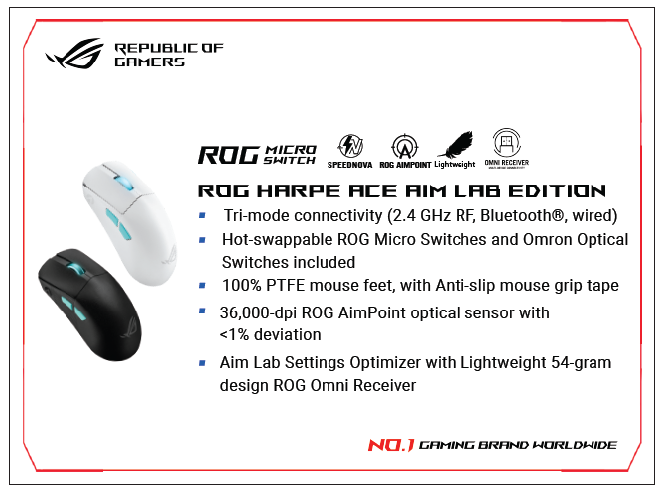
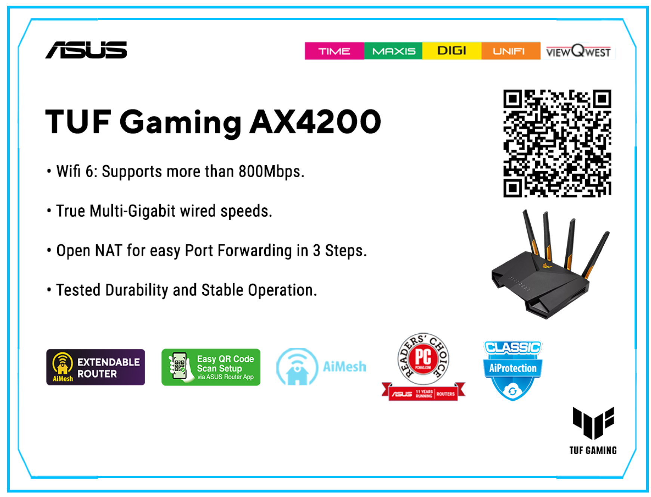
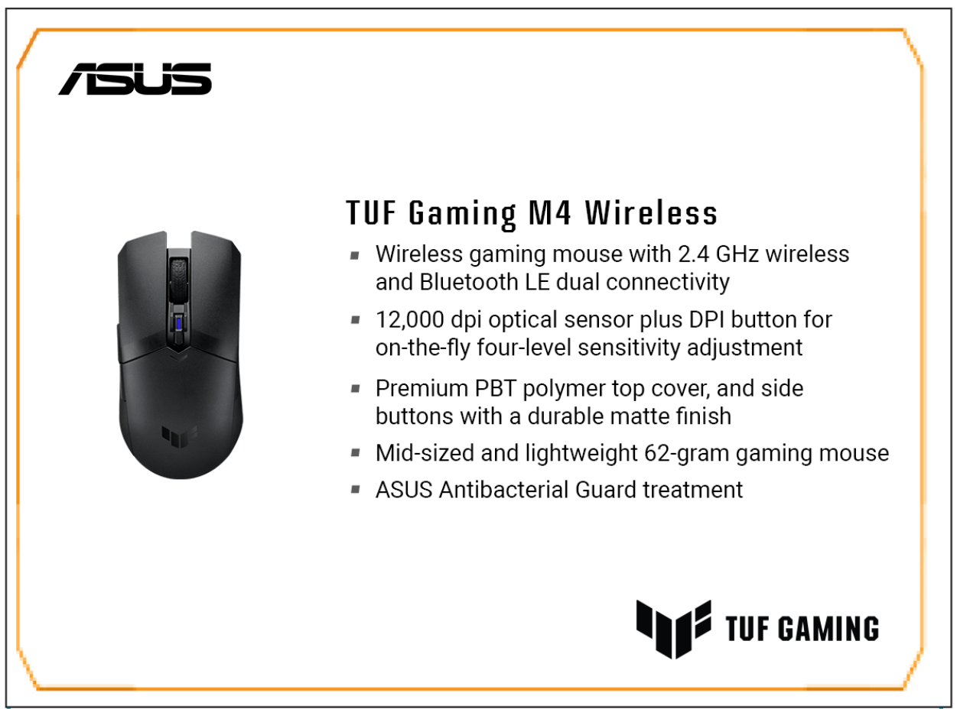
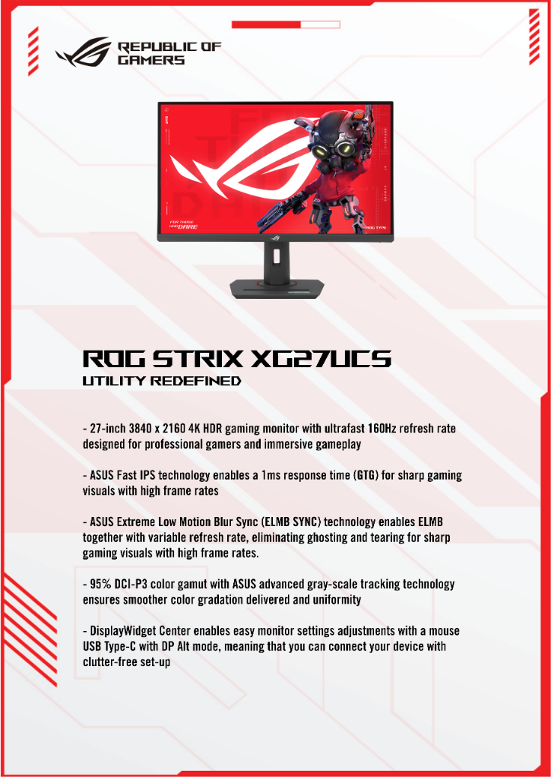
Content
Spec cards
ROG
router
TUF
A6
A5

Slide 21
Content
Spec cards
Logo
QR code
(Link to product official webpage)
Product Name
Product Pic
(optional)
KSP Logo
Awards
KSP
(Key Selling Point)
Note: all ksp should be shorten instead of copying whole sentence from website

Slide 22
Content
Double digit
Logo
Intel logo
Title
Extra info
Product Pic
Date
Free shipping & voucher
Tagline

Slide 23
Content
Promo/ PWP/ Wobbler
Logo
QR Code
(Link to event page)
Product Pic
Badge
(depending on the use of artwork)
Product Name
Promo/event related info
Title
Date
Event related info
(depending on the promo, might involve guides on how to participate…etc.)
Tagline
Logo

Slide 24

Content
Dealer Logo
Promo/ PWP/ Wobbler
Logo
Title
Product Pic
Product name
Product ksp
Price
Logo

Slide 25
Any Questions?

Slide 26
Thank you

